Slide 1

ESOF 422: Advanced Software Engineering: Cyber Practices
Secure by Design (Part 1)
Domain-Driven Development, Domain Primitives, Input Validation
Reese Pearsall
Spring 2025

Slide 2

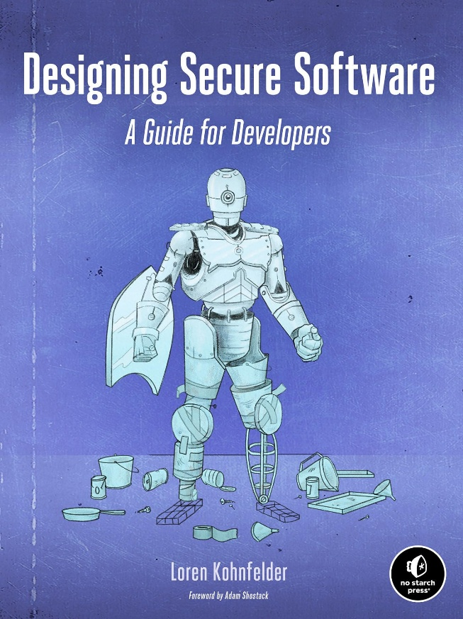
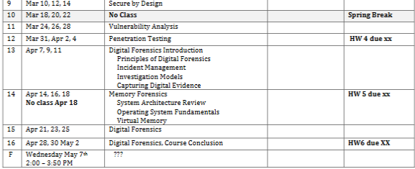
Upcoming Schedule
…things may change
Exam 3?

Slide 3
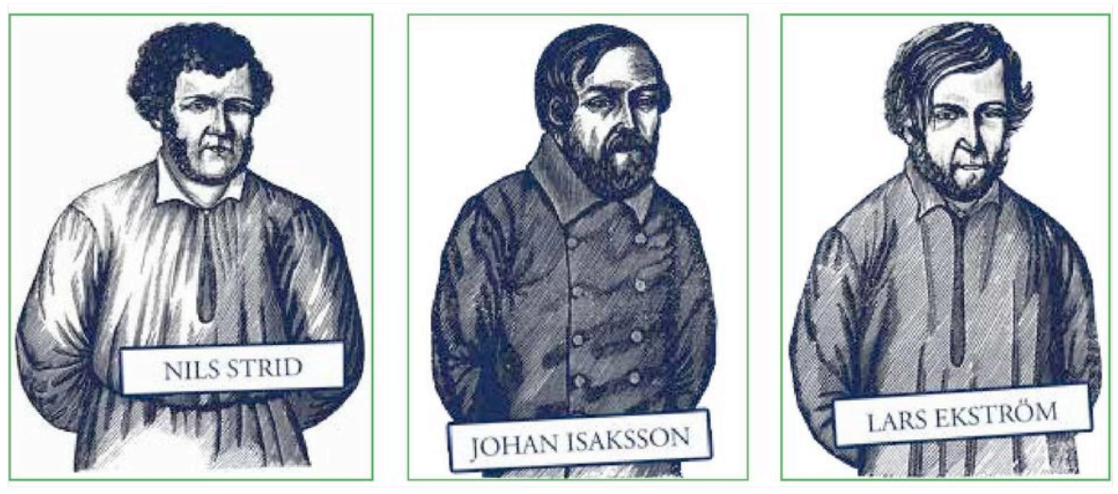
Bank Robbery in Sweden
1854- Three Swedish men rob the Öst-Götha Bank and stole $5,000,000 -$10,000,000
The bank had secure locks, high-quality hinges, but the key to open the lock was hidden above the door frame
1855- new laws mandating a certain level of bank security

Slide 4
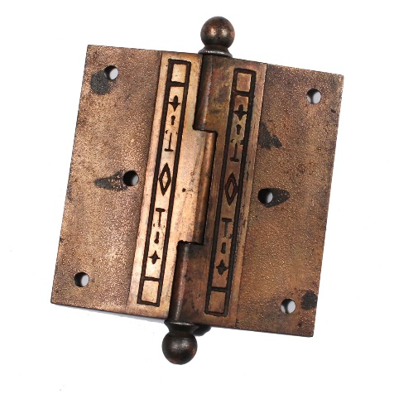

Bank Robbery in Sweden
Security Features:
Locks
Strong Hinges
Features may give the perception that security is happening, but they will fail if implemented incorrectly (design)

Slide 5
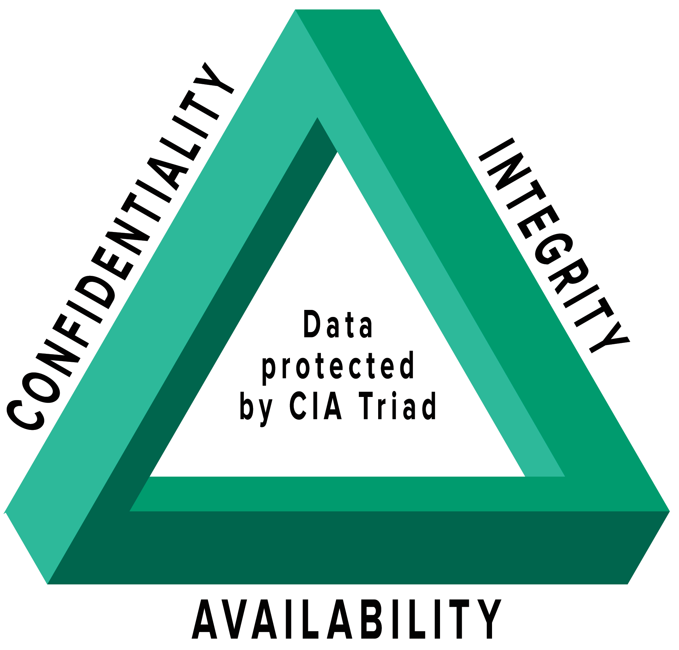
Security is a concern, not a feature
A secure design ensures features are implemented correctly
Design as a list of features
Design as a concern
These are often things adding during the software development process, after the design is decided
“Only allow authorized users to access their files”
Yes, achieving this will involve many features, but we are at least addressing security during the design step
Have a log in page with a password
Use SHA-512 Hashing
Passwords must be more than 6 characters
… this could be a very long list
Concerns fall under three types of attributes
Confidentiality – Preventing data from being disclosed to wrong people
Integrity- Preventing data from being tampered with or corrupted
Availability- Preventing services from being taken offline
Business logic usually never addresses security

Slide 6


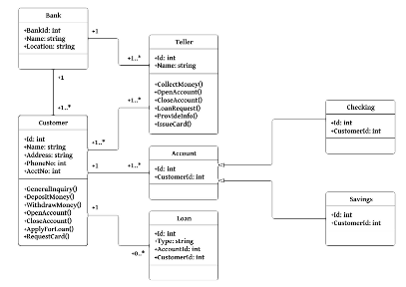
Secure by Design
Software engineers are not security experts, and engineers are often not thinking about security while writing code
If they are, security is usually a second priority
Secure by design is a mindset that emphasizes strong principles and practices for writing secure code, that result in security being a natural outcome
Good design can yield a lot of security benefits
It is a concern that must be addresses at every level of the system (Code, OS, Network, Physical)
Disclaimer: This is not the 100% totally correct way to create software, but rather this is a specific lens to view the software development process through

Slide 7

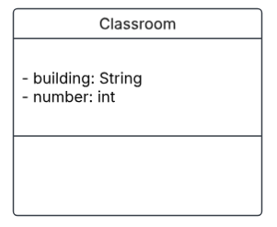
Modeling a Classroom in Code
public class Classroom {
private String building;
private int number;
}

Slide 8



Modeling a Classroom in Code
public class Classroom {
private String building;
private int number;
}
number is an integer. According to math, integers have the following properties:
Closure: a + b = integer
Associativity: a + (b + c) = (a + b) + c
Commutativity: a + b = b + a
Identity: a + 0 = a
Inverse: a + (−a) = 0
Peano's Axioms (Natural Numbers)
Zero is a number
If n is a number, the successor of n is a number
Zero isn’t the successor of a number
Two numbers of which the successors are equal are themselves equal
If a set S of numbers contains zero and also the successor of every number in S, then every number is in S
-20, 0, 20 are all integers

Slide 9

Modeling a Classroom in Code
public class Classroom {
private String building;
private int number;
}
Is this a “valid” classroom ?

Slide 10
Modeling a Classroom in Code
public class Classroom {
private String building;
private int number;
}
Is this a “valid” classroom ?
In the context of Java Integers, this is valid !
In the context of a Building/Classroom, this is not valid !

Slide 11
Modeling a Classroom in Code
public class Classroom {
private String building;
private int number;
}
Is this a “valid” classroom ?

Slide 12
Modeling a Classroom in Code
public class Classroom {
private String building;
private int number;
}
Is this a “valid” classroom ?
In the context of Java Integers, this is valid !
In the context of a Building/Classroom, this is not valid !

Slide 13
Our current design assumes that the mathematical definition for an integer suffices for the context of Classroom Numbering
Classroom Numbering Domain
Integer
Math Domain

Slide 14
In reality, an integer in Math and an integer in Classroom numbering are very different, because they are two very different domain
Classroom Numbering Domain
RoomNumber
Integer
Math Domain

Slide 15
Modeling a Classroom in Code
public class Classroom {
private String building;
private ??? number;
}

Slide 16
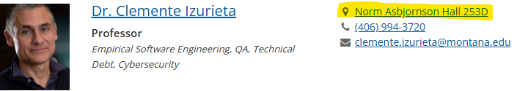
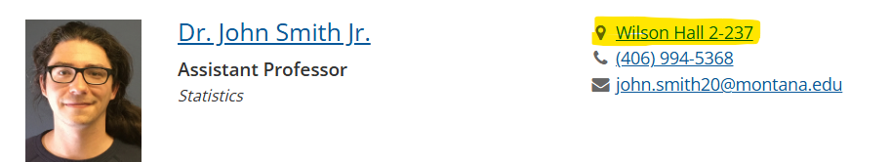
Modeling a Classroom in Code
public class Classroom {
private String building;
private String number;
}
(these aren’t “classrooms”, but their may be a room number that includes a letter or a “-” !)
How about a String ?
A String can represent almost anything

Slide 17
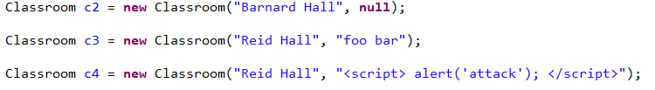
Modeling a Classroom in Code
How about a String ?
public class Classroom {
private String building;
private String number;
}
A String can represent almost anything
What characters are valid ?
What operations are allowed ?
Does it make sense ?
String encompasses a lot more possible inputs, which could lead to some strange, invalid objects

Slide 18
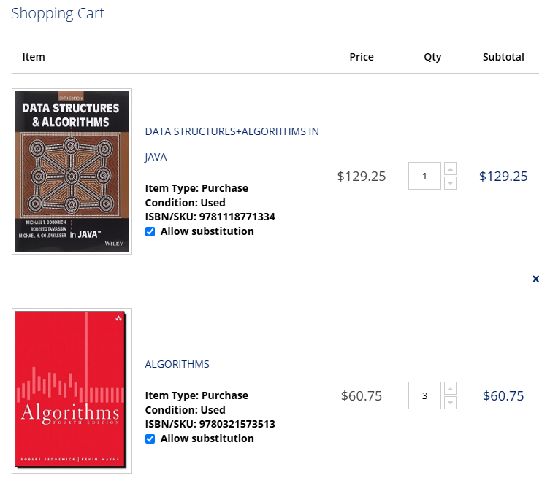
Web Shop
public class BookOrder {
private String title;
private String isbn;
private int quantity;
}
public class Cart {
private List<BookOrder> cart;
private String customer_email;
}

Slide 19

Web Shop
public class BookOrder {
private String title;
private String isbn;
private int quantity;
}
public class Cart {
private List<BookOrder> cart;
private String customer_email;
}
quantity is represented by a Java int
Possible int values: -2 billion to 2 billion
(This is rarely a good representation of anything in the real world)

Slide 20
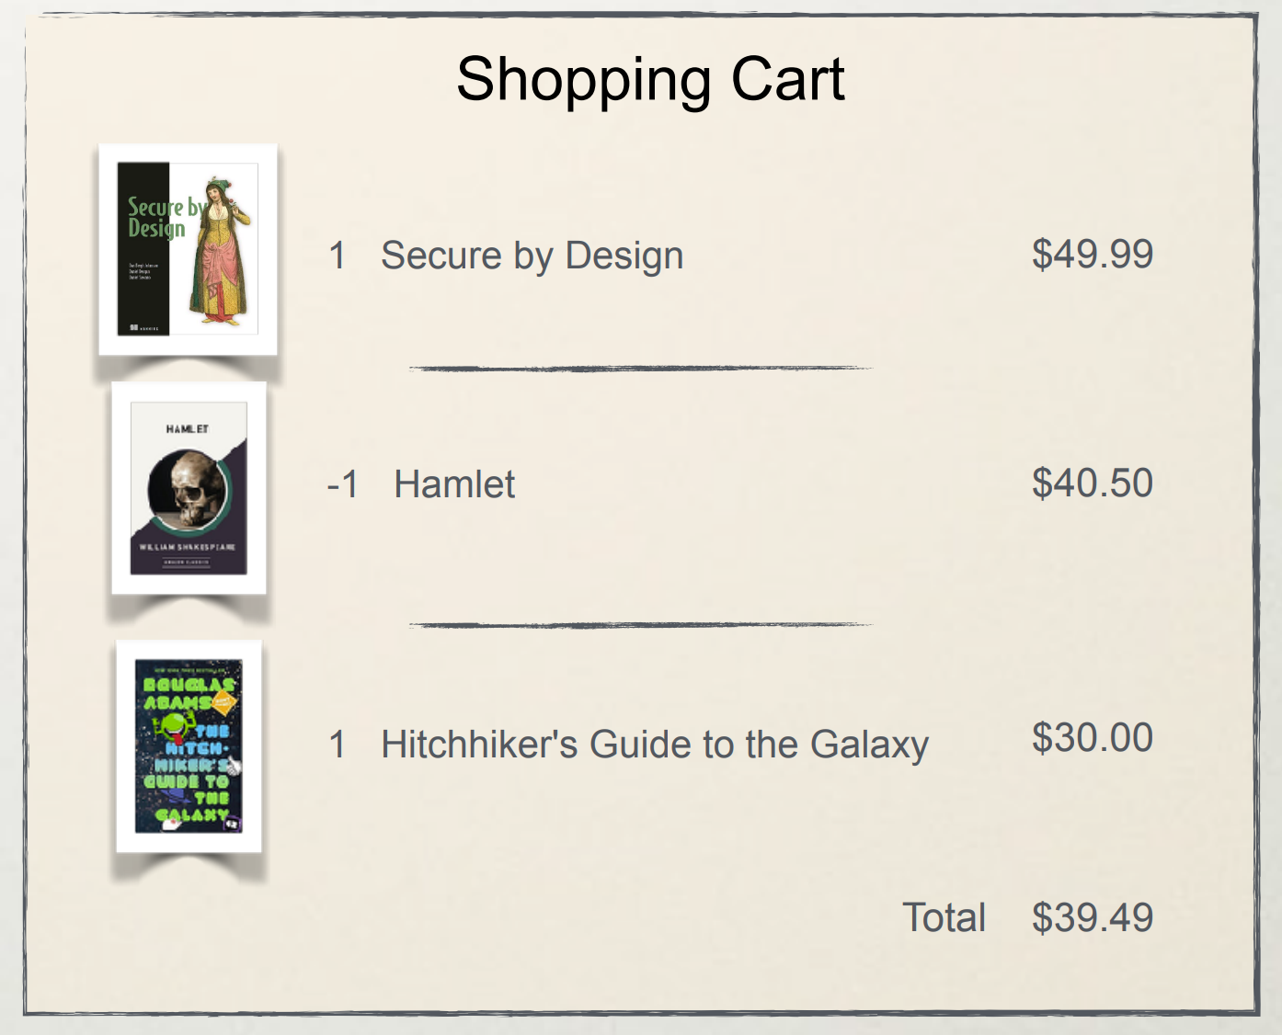

Web Shop
public class BookOrder {
private String title;
private String isbn;
private int quantity;
}
-1 is a valid integer
We expect users to enter a positive integer, but there is nothing that is stopping a user from setting a quantity of one
This could lead to the web shop paying someone the price instead of the customer paying them the price

Slide 21
Web shop Context
The quantity of an order is an integer, but within the context of a web shop there are implicit rules about the quantity of an order
quantity
Must be greater than 0
Probably less than 99
Integer
Math Context

Slide 22
public class BookOrder {
private String title;
private String isbn;
private int quantity;
}
public class BookOrder {
private String title;
private String isbn;
private Quantity quantity;
}
Refactor

Slide 23

public class BookOrder {
private String title;
private String isbn;
private int quantity;
}
public class BookOrder {
private String title;
private String isbn;
private Quantity quantity;
}
Refactor
We create our own implementation of what Quantity means within our domain
public class Quantity {
private final int value;
public Quantity(final int value) throws Exception {
if(!inclusiveBetween(1,99)){
throw new Exception("Invalid Quantity");
}
this.value = value;
}
}
Our implicit rules for what makes a valid quantity is now explicit

Slide 24

public class BookOrder {
private String title;
private String isbn;
private int quantity;
}
public class BookOrder {
private String title;
private String isbn;
private Quantity quantity;
}
Refactor
We create our own implementation of what Quantity means within our domain
public class Quantity {
private final int value;
public Quantity(final int value) throws Exception {
if(!inclusiveBetween(1,99)){
throw new Exception("Invalid Quantity");
}
this.value = value;
}
}
Our implicit rules for what makes a valid quantity is now explicit
Now Rejected !

Slide 25

-
Integer
Math Context
Web shop Context
Rejected
-1
Quantity {1 – 99}

Slide 26
Quantity is now a domain primitive
public class BookOrder {
private String title;
private String isbn;
private Quantity quantity;
}
Domain Primitive: A value object so precise in its definition that it, by its mere existence, manifests its validity is called a Domain primitive
Can only exist if its value is valid
Building block that’s native to your domain
Valid in the current context
Immutable
public class Quantity {
private final int value;
public Quantity(final int value) throws Exception {
if(!inclusiveBetween(1,99)){
throw new Exception("Invalid Quantity");
}
this.value = value;
}
}

Slide 27
Quantity is now a domain primitive
public class BookOrder {
private String title;
private String isbn;
private Quantity quantity;
}
Domain Primitive: A value object so precise in its definition that it, by its mere existence, manifests its validity is called a Domain primitive
Can only exist if its value is valid
Building block that’s native to your domain
Valid in the current context
Immutable
public class Quantity {
private final int value;
public Quantity(final int value) throws Exception {
if(!inclusiveBetween(1,99)){
throw new Exception("Invalid Quantity");
}
this.value = value;
}
}
Domain primitive enforce domain rule validation at creation time
Tightens our design by explicitly stating requirements and assumptions
Deeper modeling

Slide 28
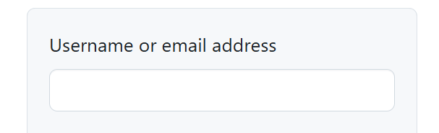

public class Cart {
private List<BookOrder> cart;
private String customer_email;
}
Let’s think about email…
It makes sense for an email to be a String
There are a lot of funky strings though…

Slide 29

public class Cart {
private List<BookOrder> cart;
private String customer_email;
}
Let’s think about email…
It makes sense for an email to be a String
There are a lot of funky strings though…
This is untrusted user input
eviluser

Slide 30
public class Cart {
private List<BookOrder> cart;
private String customer_email;
}
Let’s think about email…
It makes sense for an email to be a String
There are a lot of funky strings though…
This is untrusted user input
A user could provide a rather unexpected user input
eviluser@gmail.com;DROP TABLE USERS

Slide 31
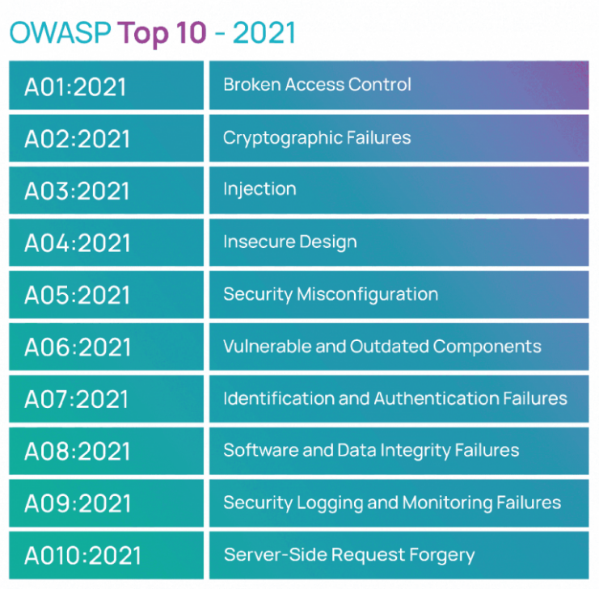
public class Cart {
private List<BookOrder> cart;
private String customer_email;
}
Let’s think about email…
It makes sense for an email to be a String
There are a lot of funky strings though…
This is untrusted user input
A user could provide a rather unexpected user input
<script> alert(“EVIL”); </script>
XSS and code injections are still a very common and severe in today’s world
Cross-Site-Scripting (XSS) Attack:
Code injection attack where victim executes JavaScript that was injected by attacker

Slide 32
public class Cart {
private List<BookOrder> cart;
private String customer_email;
}
Let’s think about email…
It makes sense for an email to be a String
There are a lot of funky strings though…
This is untrusted user input
A user could provide a rather unexpected user input
<script> alert(“EVIL”); </script>
Unexpected Input can lead to unexpected behavior. Unexpected behavior can lead to security vulnerabilities

Slide 33
public class Cart {
private List<BookOrder> cart;
private String customer_email;
}
Let’s think about email…
A hacker looks at this
A programmer looks at this
It makes sense for an email to be a String
There are a lot of funky strings though…
This is untrusted user input
A user could provide a rather unexpected user input
<script> alert(“EVIL”); </script>
Unexpected Input can lead to unexpected behavior. Unexpected behavior can lead to security vulnerabilities

Slide 34
public class Cart {
private List<BookOrder> cart;
private String customer_email;
}
Let’s think about email…
It makes sense for an email to be a String
There are a lot of funky strings though…
This is untrusted user input
A user could provide a rather unexpected user input
<script> alert(“EVIL”); </script>
Treat any area of untrusted user input as possible malicious input

Slide 35


public class Cart {
private List<BookOrder> cart;
private String customer_email;
}
public class Cart {
private List<BookOrder> cart;
private Email customer_email;
}
Refactor email to be a domain primitive
public class Email {
private final String value;
public Email(final String value) throws Exception {
if(!isValidEmail(value)) {
throw new Exception("Invalid email");
}
this.value = value;
}
private boolean isValidEmail(String value) {
String regex = "^[a-zA-Z0-9]+@[a-zA-Z0-9]+$";
Pattern pattern = Pattern.compile(regex);
Matcher matcher = pattern.matcher(value);
return matcher.matches();
}
}
Ensures that only valid objects are created
Logic for checking of valid email address for our web shop domain*

Slide 36
Secure Design and Domain Primitives
The Email primitive enforce domain rule validation at creation time.
This reduced the attack vector to data that meets the rules in the context where it’s used
<script> alert(“EVIL”) </script> doesn’t meet the rules (fails the regex) and is rejected by design
Principle of Fail-Fast: detect and respond to errors as early of possible. If in invalid state occurs (such as invalid object creation), do not let program proceed with invalid state. Program deals with invalid state → Weird things happen → Potential Vulnerabilities
Fail-Fast is part of our design w/ Domain Primitives, which makes our application more secure

Slide 37
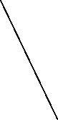
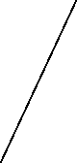
Domain-Driven Design: focus of modeling software to match a domain according to input from domain experts. Divide system into bounded contexts (domain primitives), each having their own model
Shallow modeling (bad) → Deep Modeling (good)
Email
email: Email
(validation methods)
BookTitle
title: String
(validation methods)
Isbn
isbn: String
(validation methods)
BookOrder
title: BookTitle isbn: Isbn quantity: Quantity
…
Cart
cart: List<BookOrder> email: Email
…
Quantity
quantity: int
(validation methods)
BookTitle, Isbn, Quantity, Email are all domain primitives

Slide 38


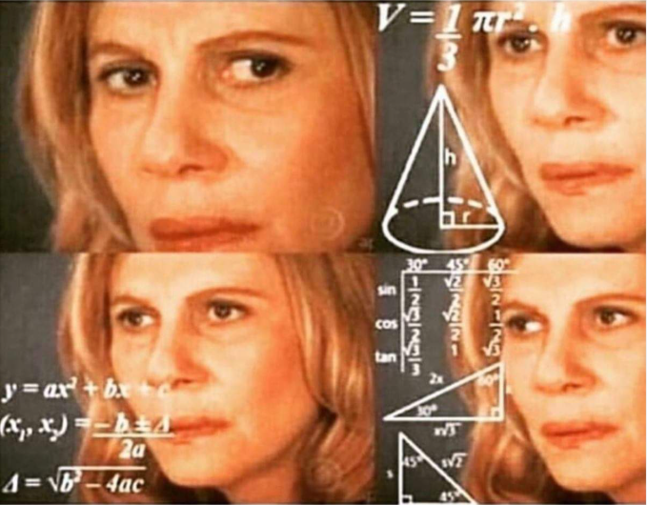
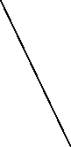
Too many classes?
Overly Complex ?
Performance?
Email
email: Email
(validation methods)
BookTitle
title: String
(validation methods)
Isbn
isbn: String
(validation methods)
BookOrder
title: BookTitle isbn: Isbn quantity: Quantity
…
Cart
cart: List<BookOrder> email: Email
…
Quantity
quantity: int
(validation methods)
BookTitle, Isbn, Quantity, Email are all domain primitives

